Slide 1
WPM DASHBOARD DESIGN IDEAS
Five High-Level
Dashboard Concepts
Visual mock-ups to guide the Power BI redesign
01 Executive Dashboard
02 Product Summary
03 Bowler
04 Project Health Status
05 Artefacts & Tollgate Closure
Design concepts only • Illustrative data
Notes:
[Sources]
- Dashboard concepts are based on the WPM Projects Dashboard and Bowler structure discussed in this conversation.
- Artefacts and Tollgate Closure concept is based on the WPM Playbook five-phase tollgate structure.
[/Sources]

Slide 2
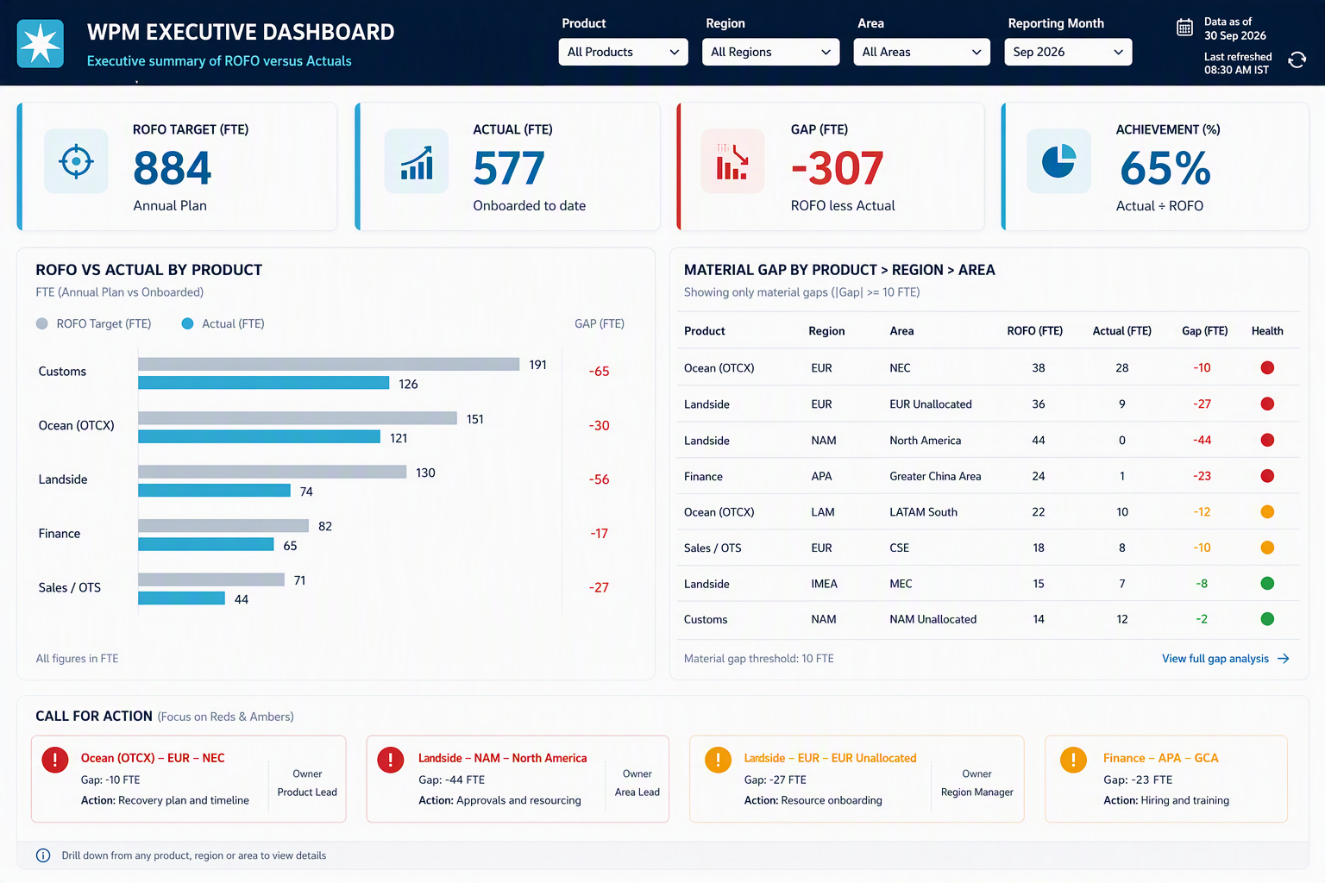
Notes:
[Sources]
- Visual on this slide was generated with Microsoft Copilot.
- Executive Dashboard is a design mock-up with illustrative values.
[/Sources]

Slide 3
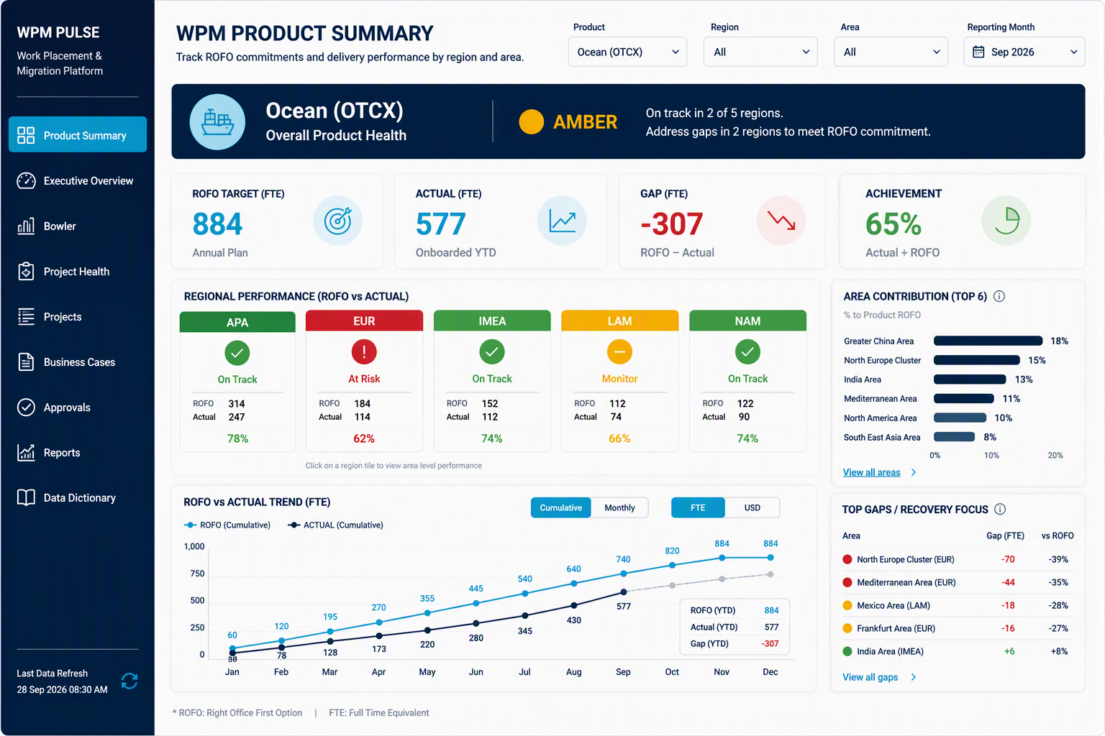
Notes:
[Sources]
- Visual on this slide was generated with Microsoft Copilot.
- Product Summary Dashboard is a design mock-up with illustrative values.
[/Sources]

Slide 4
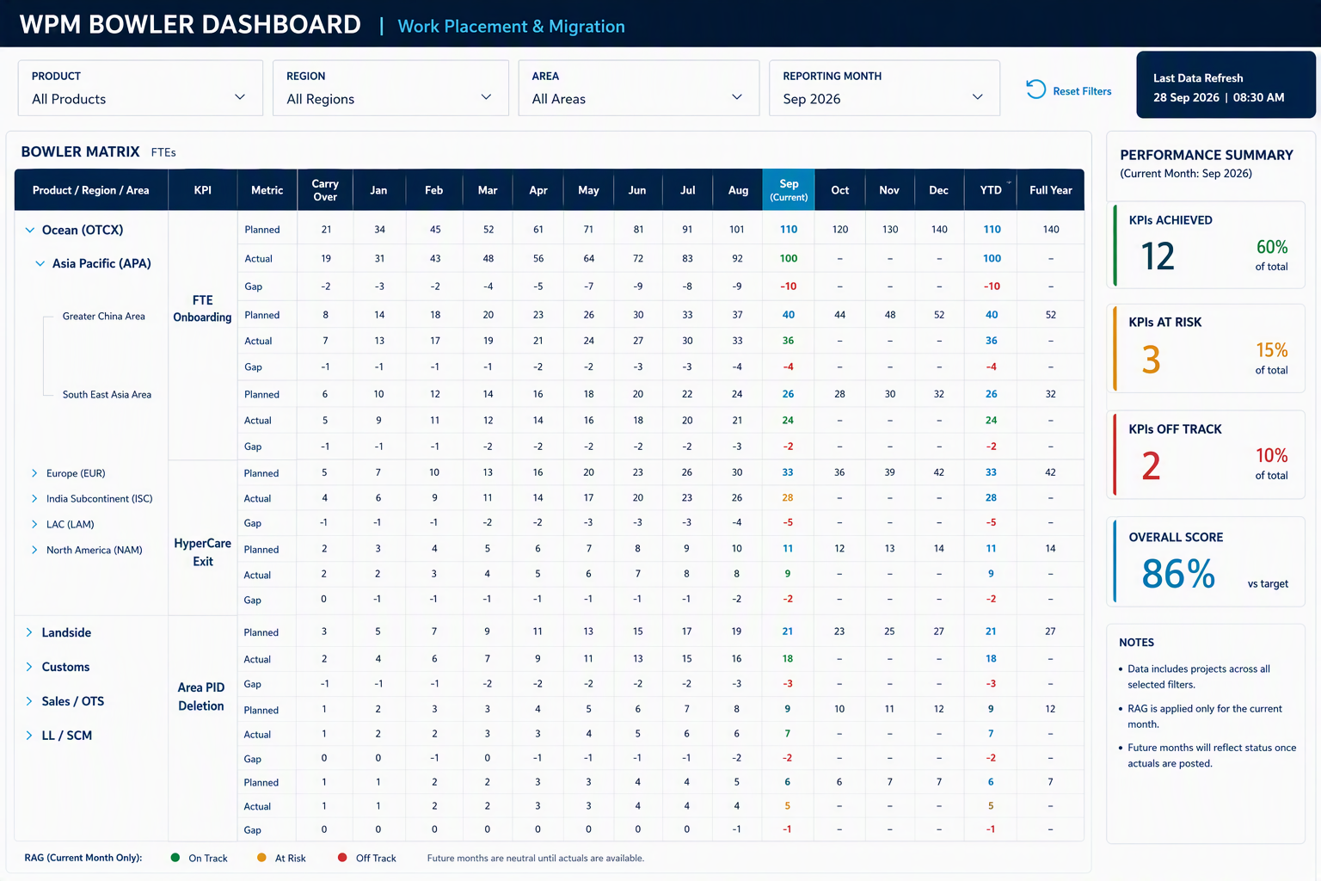
Notes:
[Sources]
- Visual on this slide was generated with Microsoft Copilot.
- Bowler Dashboard is a design mock-up with illustrative values.
[/Sources]

Slide 5
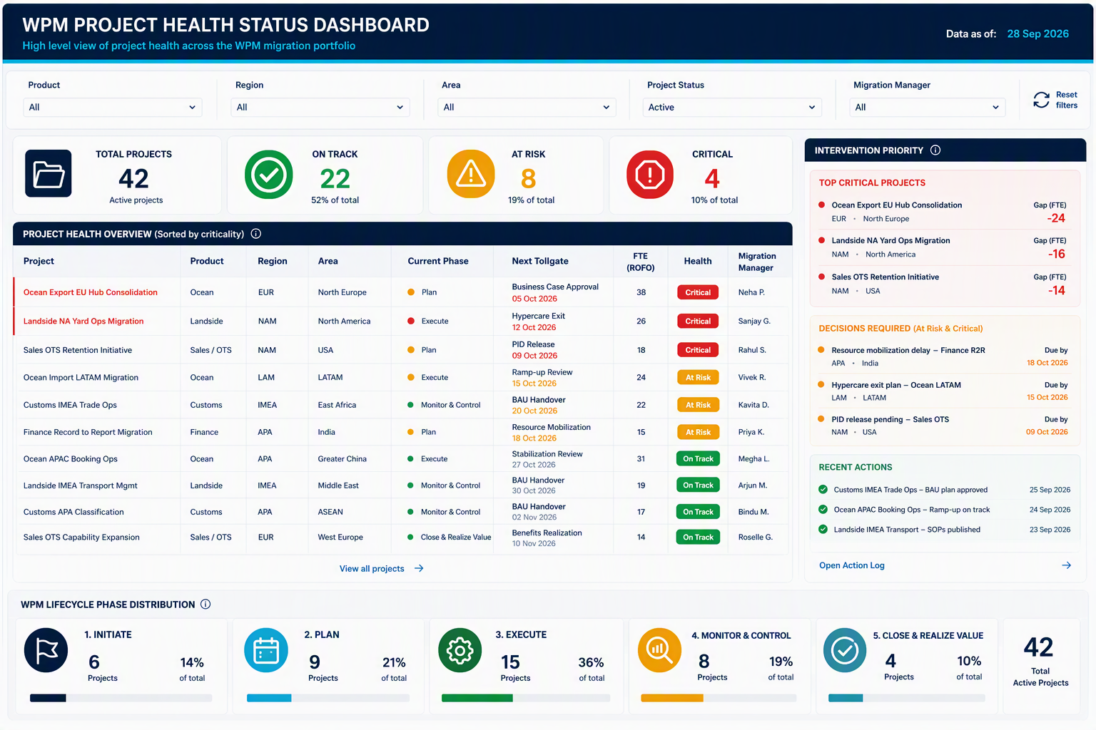
Notes:
[Sources]
- Visual on this slide was generated with Microsoft Copilot.
- Project Health Status Dashboard is a design mock-up with illustrative values.
[/Sources]

Slide 6
WPM ARTEFACTS & TOLLGATE CLOSURE DASHBOARD
Evidence readiness and closure governance
Product
Region
Area
Phase
Reporting Month
All
⌄
All
⌄
All
⌄
All 5 phases
⌄
Sep 2026
⌄
Last refresh • 28 Sep 2026
TOTAL ARTEFACTS
COMPLETE
PENDING / DUE
OVERDUE
EVIDENCE COMPLIANCE
186
142
31
13
76%
Complete and filed before closure
TOLLGATE CLOSURE READINESS
CLOSURE ACTION REQUIRED
TG1
INITIATE
TG2
PLAN
TG3
EXECUTE
TG4
MONITOR & CONTROL
TG5
CLOSE & VALUE
TG4
Hypercare evidence
BC approved
Plan signed
KT signed
Hypercare signed
BAU & benefits
Ocean • EUR
Due now
82%
71%
68%
55%
44%
TG5
Benefits confirmation
Landside • NAM
Overdue
ARTEFACT COMPLETION MATRIX
TG2
Infrastructure sign-off
Project
Phase
Required evidence
Filed
Owner
Status
Customs • APA
Due this cycle
Ocean EU Hub
TG4
Hypercare exit certificate • KPI evidence
4/6
WPM
RED
TG3
KT validation record
Landside NA
TG5
Benefits confirmation • BAU sign-off
3/5
WPM
RED
Finance • IMEA
Due this cycle
Customs APA
TG2
Project plan • readiness sign-offs
6/7
PMO
AMBER
Finance IMEA
TG3
KT sign-off • competency records
5/6
GSC
AMBER
Ocean GCA
TG1
Business case • placement decision
8/8
WPM
CLOSED
View action log →
Closure rule
A tollgate closes only when required evidence is complete and filed • Missing evidence remains an open risk
Open Artefact Library →
Notes:
[Sources]
- Internal source: Work Placement and Migration Playbook_v2.2.docx, Sections 6–7.
- The five tollgates are TG1 Business case approved; TG2 Project plan sign-off; TG3 Knowledge transfer sign-off; TG4 Hypercare sign-off; TG5 Benefits and BAU sign-off.
- The playbook states that a phase exits only when every condition is evidenced, and evidence must be filed before tollgate review.
- Values on this slide are illustrative design data.
[/Sources]

Slide 7
MIGRATION COMMITMENT & DELIVERY
1 Commitment
2 Readiness funnel
3 Timeline 2027
4 Service & MSP
5 Value & asks
Are we delivering the commitment? Target → Actual → Forecast → Gap
REGION
AREA
COUNTRY
PRODUCT
PERIOD
All
▾
All
▾
All
▾
All
▾
Jan–Sep 2026 YTD
▾
Data as of 28 Oct 2026
TARGET (ROFO)
ACTUAL DELIVERED
FORECAST – APPROVED
FORECAST – PENDING
GAP TO COMMITMENT
OUTLOOK
884
577
168
74
−65
AT RISK
Annual commitment, FTE
65% of target
Signed PIDs • 19%
Awaiting approval • 8%
Uncovered FTE • 7%
93% covered incl. pending
TARGET → ACTUAL → FORECAST → GAP BY REGION (FTE)
ONGOING MIGRATIONS
42 active
ON TIME
DELAYED
YET TO START
26 62%
9 21%
7 17%
Region | Target | Actual | Fcst approved | Fcst pending | Gap | Coverage
APA | 214 | 167 | 30 | 10 | −7 | 97%
EUR | 184 | 114 | 38 | 18 | −14 | 92%
IMEA | 152 | 112 | 26 | 8 | −6 | 96%
LAM | 132 | 74 | 28 | 14 | −16 | 88%
NAM | 202 | 110 | 46 | 24 | −22 | 89%
Total | 884 | 577 | 168 | 74 | −65 | 93%
BY COUNTRY (DELIVERY LOCATION)
India 14
Philippines 7
Poland 6
Mexico 5
Colombia 4
China 3
South Africa 3
Illustrative design values • Filters show the current view; tabs navigate between dashboards
Notes:
[Sources]
- Values on this slide are illustrative design data, aligned to the existing Executive Dashboard (884 target / 577 actual).
- Forecast is split into approved (signed PID) and pending (awaiting approval); Gap = Target − Actual − Forecast.
- Leadership feedback: Target vs Actual vs Forecast vs Gap; migrations by region, area, country; projects delayed / on time / yet to start.
[/Sources]

Slide 8
END-TO-END READINESS FTE FUNNEL
1 Commitment
2 Readiness funnel
3 Timeline 2027
4 Service & MSP
5 Value & asks
Where do FTE drop out between opportunity and hypercare exit?
REGION
AREA
COUNTRY
PRODUCT
MSP / LEADER
All
▾
All
▾
All
▾
All
▾
All
▾
Data as of 28 Oct 2026
READINESS FUNNEL • FTE AND STAGE CONVERSION
End-to-end conversion 40% • Biggest leak: Hiring −241 FTE
OPPORTUNITY
APPROVAL
PID
HIRING
KT
GO-LIVE
HYPERCARE EXIT
1,450
›
1,232
›
1,096
›
855
›
761
›
668
›
577
100% of opportunity
85% of opportunity
76% of opportunity
59% of opportunity
52% of opportunity
46% of opportunity
40% of opportunity
Start • 14 days
Conv. 85% • 18 days
Conv. 89% • 12 days
Conv. 78% • 38 days
Conv. 89% • 42 days
Conv. 88% • 6 days
Conv. 86% • 60 days
BOTTLENECK
STAGE CONVERSION BY REGION (%)
■ ≥85 ■ 80–84 ■ <80
ACTIONS ON BOTTLENECKS • MSP / LEADER
Region | Approval | PID | Hiring | KT | Go-live | Hypercare exit
APA | 88% | 91% | 82% | 90% | 89% | 88%
EUR | 83% | 87% | 71% | 86% | 85% | 84%
IMEA | 86% | 90% | 80% | 91% | 90% | 87%
LAM | 84% | 88% | 74% | 87% | 86% | 85%
NAM | 85% | 89% | 79% | 89% | 88% | 86%
Hiring • EUR • MSP B
Regional Lead EUR
Time-to-hire 38 days vs 25 target; add second sourcing partner
Due 15 Nov
Hiring • LAM • MSP C
HR Lead LAM
Offer acceptance at 68%; review salary bands
Due 22 Nov
Approval • EUR
Area Head EUR
22 FTE awaiting business-case sign-off for 30+ days
Due 30 Nov
KT • NAM
Process Owner NAM
SME availability limits KT; secure release plan
Due 30 Nov
Illustrative design values • Filters show the current view; tabs navigate between dashboards
Notes:
[Sources]
- Values on this slide are illustrative design data.
- Funnel stages from leadership feedback: Opportunity → Approval → PID → Hiring → KT → Go-live → Hypercare Exit; conversion = stage FTE / previous stage FTE.
- Bottleneck = lowest stage conversion; actions are assigned to the MSP or leader accountable.
[/Sources]

Slide 9
2027 MIGRATION PORTFOLIO TIMELINE
1 Commitment
2 Readiness funnel
3 Timeline 2027
4 Service & MSP
5 Value & asks
All 2027 migrations on one calendar • status, overlaps and go-live clustering
REGION
AREA
COUNTRY / SITE
PRODUCT
STATUS
All
▾
All
▾
All
▾
All
▾
All
▾
Data as of 28 Oct 2026
12 migrations 379 FTE 5 regions 8 delivery sites
On track
At risk
Delayed
Not started
Hypercare
◆
Go-live
Week
Month
Quarter
REGION
MIGRATION • SITE
FTE
Q1 2027
Q2 2027
Q3 2027
Q4 2027
Jan
Feb
Mar
Apr
May
Jun
Jul
Aug
Sep
Oct
Nov
Dec
APA
Ocean Documentation • Manila
45
Build Jan–Apr
Customs Filing • Chennai
32
Build Feb–Jun
Finance R2R • Pune
28
Build Mar–Jul
EUR
Landside Operations • Krakow
40
Build Jan–May
Ocean Booking • Krakow
36
Build Apr–Aug
Sales Operations • Pune
22
Build Jun–Oct
IMEA
Customs Brokerage • Cape Town
18
Build Feb–May
Ocean Documentation • Mumbai
30
Build May–Sep
LAM
Landside Operations • Bogotá
26
Build Mar–Jul
Finance AP • Mexico City
20
Build Jul–Nov
NAM
Ocean Customer Service • Mexico City
48
Build Apr–Sep
Landside Operations • Manila
34
Build Aug–Dec • hypercare into 2028
CONCURRENT MIGRATIONS PER MONTH
2
4
6
8
9
9
8
8
6
5
3
2
PEAK LOAD
SITE OVERLAPS
GO-LIVE CLUSTERING
9 migrations run in parallel in May–Jun; protect KT and hiring capacity
Krakow Apr–Jun (76 FTE) • Pune Jun–Aug • Mexico City Jul–Oct
2 go-lives each in May, Jul and Sep; stagger hypercare support
Illustrative design values • Filters show the current view; tabs navigate between dashboards
Notes:
[Sources]
- Values on this slide are illustrative design data for the 2027 migration wave plan.
- Bars show build period to go-live (diamond) followed by hypercare (grey); colour shows readiness status.
- Concurrency row counts migrations active (build or hypercare) in each month; overlaps highlight shared delivery sites.
[/Sources]

Slide 10
SERVICE HEALTH & MSP GOVERNANCE
1 Commitment
2 Readiness funnel
3 Timeline 2027
4 Service & MSP
5 Value & asks
Are migrated services back to baseline, and are our MSPs delivering?
REGION
AREA
COUNTRY
PRODUCT
MSP
All
▾
All
▾
All
▾
All
▾
All
▾
Data as of 28 Oct 2026
QUALITY (ACCURACY)
PRODUCTIVITY INDEX
SLA ADHERENCE
WEEKS BACK TO BASELINE
97.9%
94
95.2%
11
Baseline 98.5% • −0.6 pt
Baseline 100 • −6 pts
Baseline 97.0% • −1.8 pt
Target 8 weeks • +3
SERVICE HEALTH BY MIGRATION • BASELINE → ACTUAL
STABILISATION CURVE • PRODUCTIVITY vs BASELINE
Migration | Go-live | Quality % | Productivity | SLA % | Status
Ocean EU Hub | Jun 2026 | 98.5 → 98.1 | 100 → 96 | 97.0 → 96.4 | AMBER
Landside NA | May 2026 | 98.0 → 96.2 | 100 → 88 | 96.0 → 92.5 | RED
Customs APA | Jul 2026 | 99.0 → 99.2 | 100 → 101 | 98.0 → 98.3 | GREEN
Finance IMEA | Aug 2026 | 99.5 → 99.1 | 100 → 93 | 98.0 → 96.8 | AMBER
Ocean GCA | Apr 2026 | 98.0 → 98.4 | 100 → 102 | 96.0 → 97.1 | GREEN
Sales OTS LAM | Aug 2026 | 97.5 → 96.0 | 100 → 84 | 95.0 → 89.0 | RED
MSP PERFORMANCE SCORECARD
SKILL-MAPPING GOVERNANCE
MSP | Active migrations | Hiring SLA met | Attrition (90d) | Quality | Skill-map validated | Overall
MSP A | 4 | 92% | 6% | 98.6% | 88% | GREEN
MSP B | 3 | 71% | 14% | 96.8% | 64% | RED
MSP C | 3 | 83% | 9% | 97.5% | 75% | AMBER
MSP D | 2 | 90% | 5% | 98.9% | 91% | GREEN
Roles with skill map defined
86%
Skill maps validated by SME
72%
Hires matching skill profile
81%
Skill gaps closed before KT
64%
Illustrative design values • Filters show the current view; tabs navigate between dashboards
Notes:
[Sources]
- Values on this slide are illustrative design data.
- Service KPIs compare post go-live actuals with the pre-migration baseline for Quality, Productivity and SLA.
- MSP scorecard and skill-mapping metrics respond to leadership feedback on governance of skill mapping and MSP performance.
[/Sources]

Slide 11
VALUE, SUCCESS CRITERIA & LEADERSHIP ASKS
1 Commitment
2 Readiness funnel
3 Timeline 2027
4 Service & MSP
5 Value & asks
Cost impact, readiness to publish benefits, and where leaders need to act
REGION
AREA
COUNTRY
PRODUCT
WAVE
All
▾
All
▾
All
▾
All
▾
2026–2027
▾
Data as of 28 Oct 2026
DUAL-RUN COST TO DATE
RUN-RATE SAVINGS AT EXIT
BREAK-EVEN
PUBLISH BENEFITS FROM
$2.7M
$12.0M
Q2 2027
Q3 2027
Plan $6.6M through Q4 2027
Per year, from Q4 2027
Cumulative savings > dual-run
After hypercare exit + Finance check
COST IMPACT • CUMULATIVE USD M
SUCCESS CRITERIA CHECKLIST • 2027 WAVE
Available 10/12 Fully signed 4/12
Migration (earliest starts) | Start | Checklist | Baseline | Business | GSC
Ocean Documentation • Manila | Jan | ✓ | ✓ | ✓ | ✓
Landside Ops • Krakow | Jan | ✓ | ✓ | ✓ | Pending
Customs Filing • Chennai | Feb | ✓ | ✓ | Pending | Pending
Customs Brokerage • Cape Town | Feb | ✓ | ✓ | ✓ | ✓
Finance R2R • Pune | Mar | ✓ | Pending | ✗ | ✗
Landside Ops • Bogotá | Mar | ✗ | ✗ | ✗ | ✗
KEY RISKS & MITIGATION
LEADERSHIP ACTIONS / SUPPORT REQUIRED
Risk | Impact | Mitigation | Owner | RAG
EUR hiring lag at MSP B | 22 FTE slip to Q3 | Second sourcing partner; weekly hiring stand-up | Regional Lead EUR | RED
Krakow site overlap Apr–Jun 2027 | KT strain, 76 FTE | Stagger Ocean Booking start by 4 weeks | WPM Lead | AMBER
Dual-run beyond plan | +$0.8M cost | Hard hypercare exit criteria; weekly burn review | Finance BP | AMBER
8 migrations without signed criteria | Benefits cannot be published | Make sign-off a TG2 entry condition | PMO | AMBER
1
Approve a second MSP for EUR hiring
Decision by 15 Nov 2026 • Head of GSC EUR
2
Confirm Krakow wave sequencing
Decision by 30 Nov 2026 • WPM Steering Committee
3
Mandate success-criteria sign-off before TG2
By 15 Dec 2026 • Process owners
Illustrative design values • Filters show the current view; tabs navigate between dashboards
Notes:
[Sources]
- Values on this slide are illustrative design data.
- Cost impact shows cumulative dual-run cost against cumulative savings; benefits are published once hypercare has exited and Finance has validated savings.
- Success-criteria checklist builds on the WPM tollgate evidence rules (sign-off before closure).
[/Sources]

Slide 12
WPM Pulse
Resources Tile
Visual mock-ups to guide design
Design concepts only • Illustrative data
Notes:
[Sources]
- Dashboard concepts are based on the WPM Projects Dashboard and Bowler structure discussed in this conversation.
- Artefacts and Tollgate Closure concept is based on the WPM Playbook five-phase tollgate structure.
[/Sources]

Slide 13
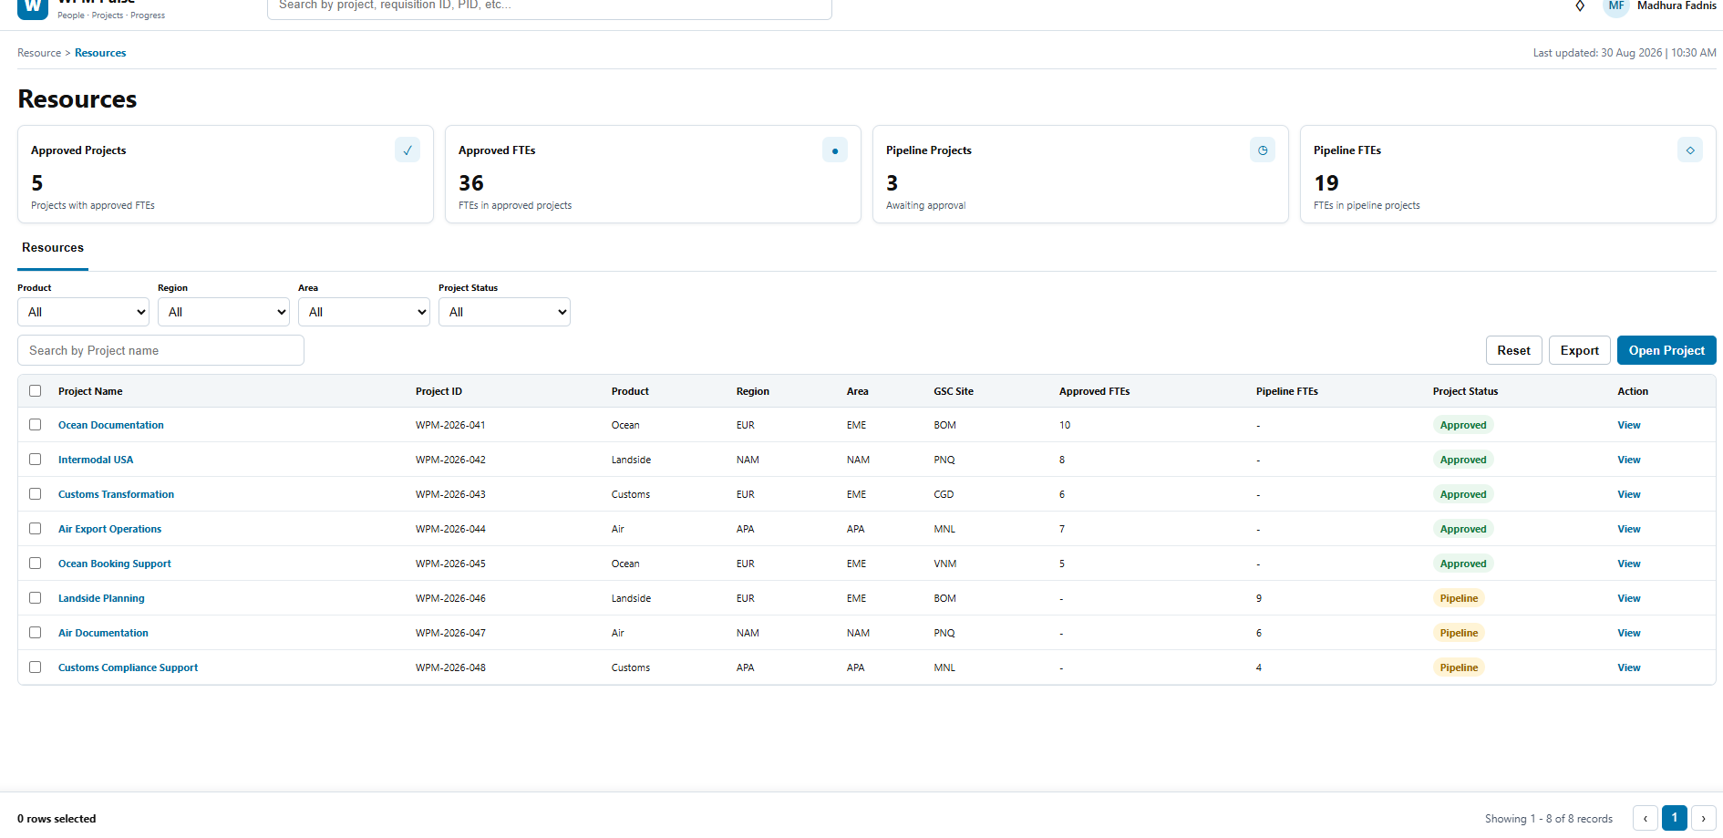
Landing page

Slide 14
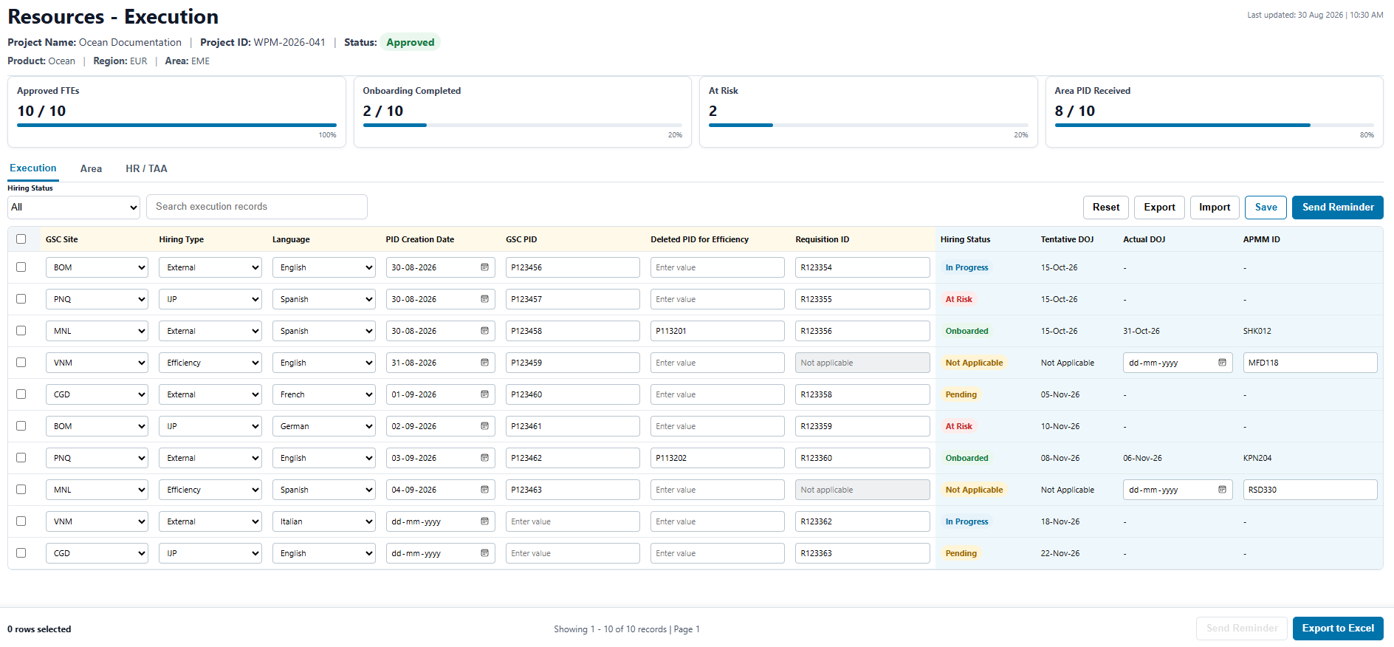
Execution View – Project Level
Notes:
Design mock-up. Project name and resource summary counts retained from the original slide 8 screenshot. The table is the original image, not a native editable table. Input/output mapping is proposed, not an implemented live connection. Inputs: Pulse project record and approved scope; Gantt plan/task record. Execution-owned updates: onboarding status, actual dates, PID release and risks. Outputs: Gantt progress/actual dates and Pulse KPIs/project health. Proposed keys: projectId, resourceId, taskId. Proposed controls: authorised edits, required IDs, validation before save, audit old/new value with user and timestamp, explicit sync error/retry handling. Field ownership, mappings and update frequency require confirmation before implementation.

Slide 15
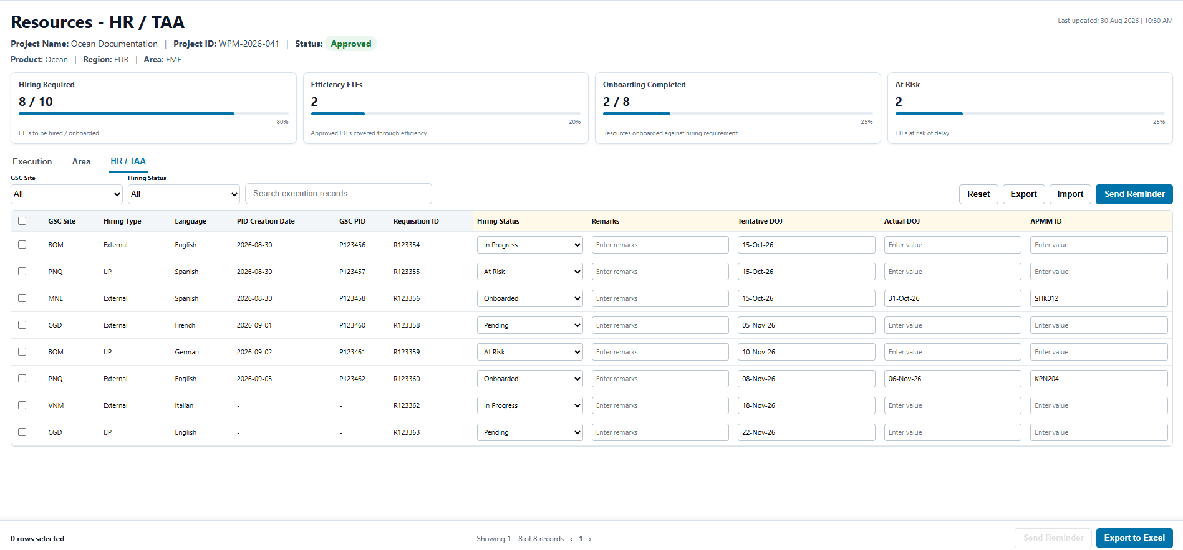
HR & TAA View – Project Level

Slide 16
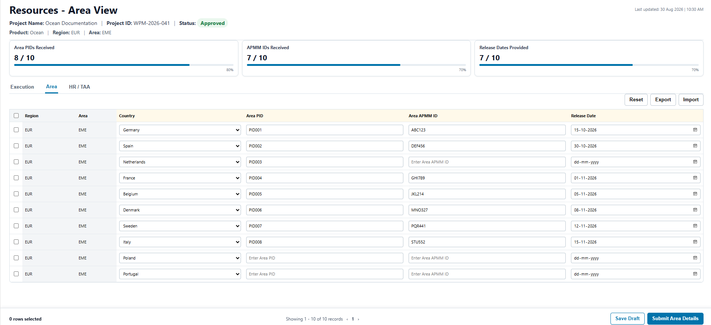
Area View – Project Level

Slide 17
WPM Pulse
Access & Enablement Requirements
Visual mock-ups to guide design
Design concepts only • Illustrative data
Notes:
[Sources]
- Dashboard concepts are based on the WPM Projects Dashboard and Bowler structure discussed in this conversation.
- Artefacts and Tollgate Closure concept is based on the WPM Playbook five-phase tollgate structure.
[/Sources]

Slide 18
Access & Enablement Requirements
Mock-up | Illustrative data | Orange numbers map to the developer guide on the next slide
Search project, request, FTE ID...
HJ
H. Jacome
Projects > Ocean EU Hub Migration > Access & Enablement
Access & Enablement
AT RISK
Export
Save draft
Submit for confirmation
Ocean EU Hub Migration | PRJ-2026-014 | Phase: Plan | Last updated 21 Oct 2026, 16:05
MIGRATING POPULATION
SYSTEMS REQUIRED
ACCESS SECURED
OPEN BARRIERS
IT READINESS
1
98 FTE
5 systems
4 / 5 systems
1 barrier
4 / 5 items
From locked Scope Statement
Recorded from catalogue
80 of 98 users fully enabled
Licensing: local booking tool
Confirmed by GSC Delivery Ops
A. System Access Status
Systems picked from catalogue drop-down (record only)
B. IT Requirements
2
5
UPDATED BY GSC DELIVERY OPS
System (drop-down)
Access / licence type
Users needed
Secured?
Barrier
Action
IT item
Required
Confirmed
Status
Salesforce ▾
Licence + Ocean EU profile
98
YES
—
Edit
Laptops (standard build)
98
98
CONFIRMED
SAP ECC (FI-AR) ▾
Role: AR clerk
40
YES
—
Edit
Headsets
98
98
CONFIRMED
ServiceNow ▾
Requester + agent role
98
YES
—
Edit
Second monitors
98
60
PENDING
SharePoint: Ocean EU docs ▾
Read / contribute
98
YES
—
Edit
VPN & network access
98
98
CONFIRMED
Local booking tool ▾
Named licence
98
NO
Licences capped at 80 seats →
Edit
MFA token / authenticator
98
98
CONFIRMED
+ Add system from catalogue
Total
4 of 5 items confirmed
All accesses secured for the migrating population?
Yes
No
4 of 5 secured
3
IT confirmation
6
Auto-set to Yes only when every system is secured
Confirmer: R. Mehta, GSC Delivery Ops Leader | Date: pending
Barrier record (required when status = No)
4
Monitors for Manila arrive 4 Nov. All other items ready for Wave 1 start.
BARRIER TYPE
AFFECTED SYSTEM
OWNER
TARGET DATE
18 additional named licences awaiting vendor PO. Wave 2 start at risk if not resolved by 30 Oct.
Licensing ▾
Local booking tool ▾
IT Procurement
30 Oct 2026
Request update
Confirm IT readiness

Slide 19
Access & Enablement: Developer Guide
Proposed fields, data sources and behaviour | Numbers match the callouts on the mock-up
# | Element | Source | Type / editable | Rules & behaviour
1 | Summary KPIs | Scope Statement (locked FTE); calculated from A and B | Number, read-only | Population = locked final FTE. Recalculates on any row change; Open barriers card turns red when > 0.
2 | Systems required | Manual input from system catalogue drop-down | Multi-select list; per row: access type, users needed | Record purposes only. Users needed defaults to population, editable. Rows can be added or removed in Draft.
3 | Access secured (overall) | Manual Yes / No per system; overall rolled up | Yes / No per row; overall auto-calculated | Overall = Yes only when every system is Yes. Any No makes a barrier record (4) mandatory.
4 | Barrier record | Manual input | Type (drop-down), system, owner, target date, text max 500 chars | Required when status = No. Overdue target date flags red and notifies the owner. Closed on resolution, kept in history.
5 | IT requirements checklist | Updated by GSC Delivery Ops leaders | Qty required (auto = population) and qty confirmed, per item | Standard item list (laptop, headset, monitor, VPN, MFA). Status: Not started / Pending / Confirmed; Confirmed when qty matches.
6 | IT confirmation | GSC Delivery Ops leader | Name, date, comment; Confirm action | Enabled only when all items are Confirmed. Time-stamped; re-opens automatically if a quantity changes.
Workflow & status
Draft: systems, statuses and IT items editable; Save draft at any time.
At risk: any system = No or any IT item not confirmed; barrier record mandatory.
Ready: all systems secured and IT readiness confirmed; Submit becomes active.
Confirmed: record frozen; usable as tollgate evidence. Re-open with reason, version +1.
Roles (proposed)
WPM lead: records systems, access status and barriers; submits.
GSC Delivery Ops leader: updates IT items and confirms IT readiness.
IT / access owners: resolve barriers. PMO and others: view only; Export.
Open points to confirm
1. Final list of standard IT items (beyond laptops, headsets, monitors, VPN, MFA)?
2. Track access per system only, or per user?
3. Who maintains the system catalogue for the drop-down?
4. Is 'all accesses secured' a tollgate gate criterion?
5. One IT confirmation per project, or per migration wave?
Suggested data model (one record per project)
AccessEnablement { projectId, status, version, populationFte (Scope), allAccessSecured (calc), itConfirmed, confirmedBy, confirmedAt }
SystemAccessLine { systemId (catalogue), accessType, usersNeeded, isSecured (Y|N), barrierId }
Barrier { barrierId, systemId, type, description, owner, targetDate, status, resolvedAt }
ITRequirementLine { itemType (laptop|headset|monitor|vpn|mfa), qtyRequired, qtyConfirmed, status, updatedBy, updatedAt }
AuditLog { action (edit | confirm | submit | reopen), field, oldValue, newValue, reason, user, timestamp }

Slide 20
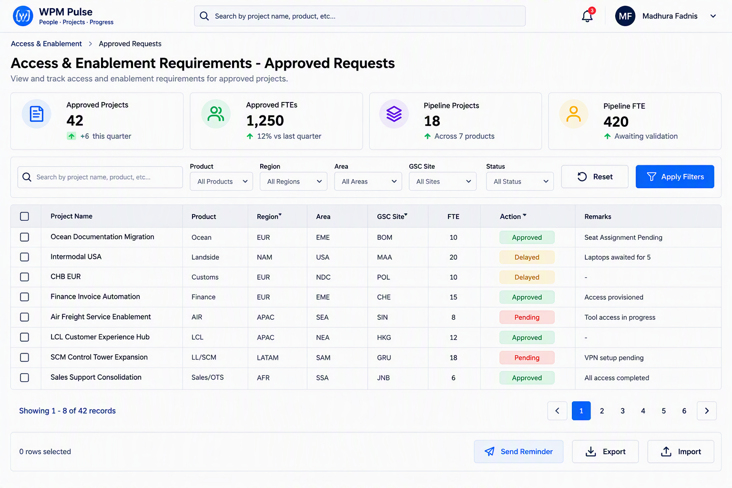
Access & Enablement Requirements
Approved _View

Slide 21
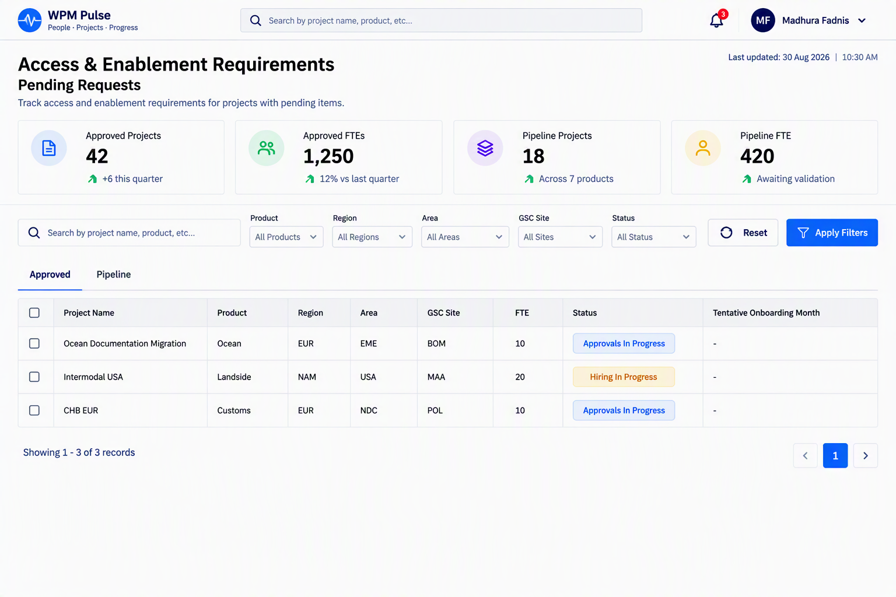
Access & Enablement Requirements
Pending _View

Slide 22
WPM Pulse
Scope Statement Tile
Visual mock-ups to guide design
Design concepts only • Illustrative data
Notes:
[Sources]
- Dashboard concepts are based on the WPM Projects Dashboard and Bowler structure discussed in this conversation.
- Artefacts and Tollgate Closure concept is based on the WPM Playbook five-phase tollgate structure.
[/Sources]

Slide 23
Scope Statement
Mock-up | Illustrative data | Orange numbers map to the developer guide on the next slide
Search project, request, FTE ID...
HJ
H. Jacome
Projects > Ocean EU Hub Migration > Scope Statement
Scope Statement
DRAFT
Export
Save draft
Submit for sign-off
Ocean EU Hub Migration | PRJ-2026-014 | Phase: Plan
AMBITION
1
AGREED IN OPP. ASSESSMENT
FINAL PROJECT FTE (LOCKED)
EXCEPTIONS (NOT AGREED)
FINAL VS AMBITION
120
102
98
18
82%
FTE
FTE
FTE
FTE
From original intake form
Agreed for migration
Official once all levels locked
Detail in Opp. Assessment
98 of 120 FTE
Headcount Agreement by Job Level
Locked final agreement = the project's official final FTE
2
3
Job level
Agreed for migration (Opp. Assessment)
Final agreement (manual)
Variance vs OA
Evidence attachment
Status
Action
4
Job Level 2
60
58
-2
MoM_Ocean_12Sep.pdf
LOCKED
Unlock
Job Level 3
30
30
0
Area_signoff_email.msg
LOCKED
Unlock
Job Level 4
12
10
-2
+ Attach evidence
OPEN
Lock final
Total
102
98
-4
2 of 3 attached
2 / 3 locked
Exceptions: Not Agreed for Migration
High-Level Scope Statement
5
READ-ONLY
6
REQUIRED
Job level
FTE not agreed
% of ambition
Migrate Ocean EU Hub order-to-cash and documentation activities from Copenhagen to GSC Mumbai and Manila. In scope: booking amendments, documentation validation and invoicing support for EUR trades. Out of scope: customer escalations and local customs filing, which remain in-country.
Job Level 2
8
6.7%
Job Level 3
6
5.0%
Job Level 4
4
3.3%
Total
18
15.0%
Check: 102 agreed + 18 exceptions = 120 ambition
View exception reasons in Opportunity Assessment >
312 / 2,000 characters

Slide 24
Scope Statement: Developer Guide
Proposed fields, data sources and behaviour | Numbers match the callouts on the mock-up
# | Element | Source | Type / editable | Rules & behaviour
1 | Ambition FTE | Original intake form | Number, read-only | Pulled on load. Baseline for coverage % and the reconciliation check. Link back to the intake form.
2 | Agreed for migration, by job level | Opportunity Assessment tab | Number per JL2 / JL3 / JL4, read-only | Synced from OA; Total auto-sums. If OA changes after a level is locked, flag the row and notify the owner.
3 | Final agreement, by job level | Manual input | Whole number >= 0, editable until locked | Variance = Final - OA (red when negative). Total auto-sums. Warn (not block) if Final > OA.
4 | Evidence + Lock, per job level | Upload / button per row | File (PDF, DOCX, MSG, XLSX); Lock / Unlock action | Locked row is read-only (user + time logged). The locked total is the project's official final FTE, used in all other views.
5 | Exceptions (not agreed) | Opportunity Assessment tab | Number per job level, read-only | Summary only; reasons stay in OA (deep link). Check Agreed + Exceptions = Ambition; flag any gap.
6 | High-level scope statement | Manual input | Free text, max 2,000 characters | Standard project scope statement. Mandatory before Submit; saved with each version.
Workflow & status
Draft: values editable; Save draft at any time.
Ready: all job levels locked and scope text filled; Submit becomes active.
Submitted / Signed off: record frozen; locked total becomes the project's final FTE of record.
Re-open: unlock with reason; status returns to Draft, version +1.
Roles (proposed)
WPM lead: edits final values, attaches evidence, locks, submits.
Area / product owner: views and signs off.
PMO and others: view only; Export to PDF / Excel.
Open points to confirm
1. Job levels fixed at JL2-JL4, or configurable?
2. Lock per job level, or one lock for the whole table?
3. Who can unlock after sign-off?
4. Does sign-off count as tollgate evidence?
Suggested data model (one record per project)
ScopeStatement { projectId, status, version, ambitionFte (intake), scopeText, finalProjectFte (locked sum), submittedAt }
JobLevelLine { jobLevel (JL2|JL3|JL4), oaAgreedFte (OA), finalFte, variance (calc), evidenceFiles[], isLocked, lockedBy, lockedAt }
ExceptionLine { jobLevel, fteNotAgreed (OA), oaRecordLink }
AuditLog { action (lock | unlock | edit | submit), field, oldValue, newValue, reason, user, timestamp }

Slide 25
WPM Pulse
Business Case Tile
Visual mock-ups to guide design
Design concepts only • Illustrative data

Slide 26
Business Case (1 of 2)
Mock-up | Illustrative data | Orange numbers map to the developer guide
Search project, request, FTE ID...
HJ
H. Jacome
Projects > Ocean EU Hub Migration > Business Case
Business Case
IN PROGRESS
Export
Save draft
Ocean EU Hub Migration | PRJ-2026-014 | Phase: Initiate | Last saved 14 Oct 2026, 10:42
1
Migration Intake Data
EDITABLE | SYNCS TO INTAKE
Source of truth: Migration Intake
View change history
Edit
MIGRATION TITLE / PROJECT NAME
MIGRATION TYPE
FUNCTION
PROCESS
Ocean EU Hub Migration
1:1 migration
Ocean
Order-to-cash & documentation
SOURCE LOCATION
DESTINATION GSC SITE
BUSINESS OWNER
TARGET TIMELINE
Copenhagen, Denmark
GSC Mumbai
M. Hansen, Head of Ocean Ops EUR
Feb 2027 - Jun 2027
INITIAL MIGRATION RATIONALE
OTHER INTAKE ATTRIBUTES
Consolidate EU hub work in GSC
Region EUR | Area North Europe
Target timeline edited 14 Oct 2026 by H. Jacome. Synced to Migration Intake and Project Attributes; financials refreshed; Opportunity Assessment approval flagged for review.
2
Scope Data
READ-ONLY | OWNED BY SCOPE
Source of truth: Scope artifact
View approval history
Go to Scope >
SCOPE: SIGNED OFF
APPROVAL: APPROVED 12 OCT 2026
ACTIVITIES IN SCOPE
Booking amendments
Documentation validation
Invoicing support (EUR trades)
ACTIVITIES OUT OF SCOPE
Customer escalations; local customs filing
ASSUMPTIONS
Volumes stable at FY2026 levels; English-only
TOTAL HEADCOUNT (FINAL, LOCKED)
MIGRATION WAVES
98 FTE
Wave 1 | Feb 2027
HEADCOUNT BY JOB LEVEL / DISTRIBUTION
50 FTE | JL2, JL3
JL2
58 (59%)
Wave 2 | Apr 2027
48 FTE | JL2, JL3, JL4
JL3
30 (31%)
No edit controls here. Scope changes are made in the Scope artifact and refresh this view automatically.
JL4
10 (10%)

Slide 27
Business Case (2 of 2)
Mock-up | Illustrative data | Same page, scrolled to Financials and Business Case details
Search project, request, FTE ID...
HJ
H. Jacome
Projects > Ocean EU Hub Migration > Business Case
Business Case
IN PROGRESS
Export
Save draft
Ocean EU Hub Migration | PRJ-2026-014 | Phase: Initiate | Last saved 14 Oct 2026, 10:42
3
Financials
SYSTEM-CALCULATED | READ-ONLY
Calculation details
Cost-rate basis
Financial history
Refresh
Basis: Copenhagen, DK > GSC Mumbai | 98 FTE from Scope (JL2 58, JL3 30, JL4 10) | Fully loaded cost rates FY2026 v3.2 | USD
CURRENT ANNUAL COST
FUTURE ANNUAL COST
ANNUAL GROSS BENEFIT
BENEFIT %
NET FIRST-YEAR BENEFIT
RECURRING ANNUAL BENEFIT
PAYBACK PERIOD
$9.38M
$2.60M
$6.78M
72.3%
$4.78M
$6.78M
3.5 mo
Editable financial inputs (owned by Business Case)
+ Add adjustment
Input
System value
Manual adjustment
Adjusted final
Adjustment reason
By
Date / time
Action
One-time migration costs
$1.85M
+$0.15M
$2.00M
Extra KT travel for Wave 2 (approved by Finance)
H. Jacome
14 Oct 2026 10:42
Edit
History
Exchange-rate assumption
EUR/USD 1.08
-
1.08
Centrally controlled rate; not editable
System
01 Oct 2026 00:00
READ-ONLY
4
Business Case Details
EDITABLE | OWNED BY BUSINESS CASE
Edit
BUSINESS RATIONALE & EXPECTED BENEFITS
RISKS & DEPENDENCIES
RECOMMENDATION & DECISION
Consolidates EU hub transactional work into one GSC team.
~72% run-rate saving; standard process across EUR trades.
KT capacity in Copenhagen during peak (Medium)
Mumbai hiring for JL4 roles (High)
Depends on: documentation system access
Recommendation: Proceed with 2-wave migration
Decision: Pending approval
Approver: M. Hansen (Business owner)
Status: In progress | Completed: - | Approved: -
Save changes
Return for revision
Complete
Approve

Slide 28
Business Case: Developer Guide (1 of 2)
Ownership matrix and required controls | Numbers match the callouts on the mock-ups
Information | Source of truth | Editable in Business Case | Editing location
Function and process | Migration Intake | Yes | Migration Intake or Business Case
Source and destination locations | Migration Intake | Yes | Migration Intake or Business Case
Business owner and timeline | Migration Intake | Yes | Migration Intake or Business Case
Activities in and out of scope | Scope artifact | No | Scope artifact only
Total headcount | Scope artifact | No | Scope artifact only
Headcount by job level | Scope artifact | No | Scope artifact only
Migration waves | Scope artifact | No | Scope artifact only
Fully loaded cost rates | Backend cost database | No | Cost administration module
Calculated financial benefits | System calculation | No | Automatically recalculated
One-time migration costs | Business Case | Yes | Business Case
Business rationale and expected benefits | Business Case | Yes | Business Case
Risks and dependencies | Business Case | Yes | Business Case
Recommendation and decision | Business Case | Yes | Business Case
Required UI controls by section
1
Migration Intake fields
Edit
Save changes
Cancel
View change history
2
Scope fields
View only
Go to Scope
View Scope status
View Scope approval history
3
Calculated financials
View calculation details
View cost-rate basis
Refresh calculation
View financial history
4
Business Case-owned fields
Core system rule
Data can be displayed in many artifacts but edited only in the artifact that owns it. Exception: Migration Intake fields can also be edited from the Business Case.
The Business Case never stores its own copy, and never edits Scope-owned data.
Edit
Save changes
Complete
Approve
Return for revision

Slide 29
Business Case: Developer Guide (2 of 2)
Data flows, calculation logic and audit rules
A Edit a Migration Intake field from the Business Case
1
User edits and saves in Business Case
2
Migration Intake field updated
3
Project Attributes database updated
4
Calculations and summaries refresh
5
Change written to audit history
6
Completed / approved artifacts flagged for review
Business Case reads and writes the same Project Attributes record; it never holds a separate copy.
B Change Scope data (always from the Scope artifact)
1
User selects Go to Scope
2
Scope artifact opens
3
User edits and saves Scope
4
Project Attributes database updated
5
Business Case refreshes automatically
6
Financials recalculated
7
Reapproval if Scope was completed / approved
Financial calculation logic (proposed)
Inputs: source location and destination GSC site (Intake), headcount by job level (Scope), fully loaded annual cost rates (cost database).
Current annual cost = sum of FTE per job level x source-location rate
Future annual cost = sum of FTE per job level x destination GSC rate
Annual gross benefit = Current - Future
Benefit % = Gross benefit / Current
Recurring annual benefit = Gross benefit (full run-rate)
Net first-year benefit = Gross benefit - adjusted one-time costs
Payback (months) = Adjusted one-time costs / (Gross benefit / 12)
Outputs are read-only. Refresh recalculates from current Intake, Scope and rates.
Adjustments, audit and approvals
Adjustments never overwrite the system baseline; both are shown side by side.
Each adjustment stores: system value, manual adjustment, adjusted final value, reason (mandatory), user, date and time.
On Refresh the baseline recalculates; existing adjustments stay visible and re-apply.
Every edit writes an audit entry; edits touching a completed / approved artifact raise an approval flag.
Suggested records
FinancialAdjustment { field, systemValue, adjustment, adjustedValue, reason, user, timestamp }
AuditEntry { artifact, field, oldValue, newValue, editedFromArtifact, user, timestamp }
ApprovalFlag { artifact, triggeredBy, reason, status }

Slide 30
WPM Pulse
Stakeholder Registration Tile
Visual mock-ups to guide design
Design concepts only • Illustrative data

Slide 31
Stakeholder Registration (1 of 2)
Mock-up | Illustrative data | Orange numbers map to the developer guide
Search project, request, FTE ID...
HJ
H. Jacome
Projects > Ocean EU Hub Migration > Stakeholder Registration
Stakeholder Registration
IN PROGRESS
Export
Save draft
Ocean EU Hub Migration | PRJ-2026-014 | Phase: Initiate | Last saved 14 Oct 2026, 10:42
1
Project Stakeholders
AUTO + MANUAL
Who is involved in this project
Lock all
+ Add person
2
12 of 13 roles filled
1 TO ASSIGN
3 TO LOCK
Click a card to edit
3
Auto = from systems
4
Lock = confirmed
LEADERSHIP 4
AREA 3
GSC 4
PROJECT TEAM 2
PROJECT SPONSOR
LOCKED
AREA POC (MIGRATION OWNER)
LOCKED
GSC HEAD-1
Lock
WPM FOCALS
LOCKED
AK
A. Kristensen
MH
M. Hansen
AUTO
VR
V. Rao
AUTO
HJ
DC
H. Jacome +1
AUTO
ELT
AREA SME
Lock
GSC SME
LOCKED
MSP FOCALS (IF APPLICABLE)
LOCKED
+ Assign person (required)
SN
PL
S. Nielsen +1
RI
R. Iyer
MA
MB
2 MSPs assigned
AREA FUNCTIONAL LEADER
FPO (IF APPLICABLE)
GSC FBP
Lock
View MSP focals >
LOCKED
LM
L. Moreau
AUTO
Not applicable
NM
N. Mehta
AUTO
GPL
LOCKED
GSC BPM
LOCKED
KS
K. Shah
AUTO
AP
A. Pillai
AUTO

Slide 32
Stakeholder Registration (2 of 2)
Mock-up | Edit panel, MSP focals and change log
Search project, request, FTE ID...
HJ
H. Jacome
Projects > Ocean EU Hub Migration > Stakeholder Registration
Stakeholder Registration
IN PROGRESS
Export
Save draft
Ocean EU Hub Migration | PRJ-2026-014 | Phase: Initiate | Last saved 14 Oct 2026, 10:42
MSP Focals
One focal per MSP
Edit stakeholder: Area SME
X
5
EXPANDED ROW
+ Add MSP
7
MSP | Service / scope | Focal | Actions
MSP A (TBC) | Transition & KT | T. Berg | Edit | Unlock
MSP B (TBC) | Ongoing delivery | + Assign person | Assign
DRAFT
SOURCE: MANUAL
ASSIGNED PEOPLE
S. Nielsen s.nielsen@company.com | Ocean Ops, Copenhagen
Remove
P. Larsen p.larsen@company.com | Documentation, Copenhagen
Remove
MSP list to be confirmed
The applicable MSPs and their focal roles will be provided separately. The row stays collapsed in the registry and expands to one line per MSP.
Search directory by name or email...
+ Add person
About this role
Subject-matter expert from the area. Supports scope definition and knowledge transfer.
6
Change Log
AUDIT
Every edit, lock and unlock
14 Oct 2026 10:42
H. Jacome
Locked GSC SME: R. Iyer
NOTES (OPTIONAL)
Add a note...
14 Oct 2026 10:30
System
Auto-populated GSC Head-1 and GSC FBP from backend tables
Locked people are used for approvals and notifications in this project. Unlocking reopens the record and is logged.
13 Oct 2026 16:05
M. Hansen
Unlocked Area SME; added P. Larsen
12 Oct 2026 09:12
H. Jacome
Replaced Project sponsor; 1 pending approval reassigned
Cancel
Save draft
Save and lock

Slide 33
Stakeholder Registration: Developer Guide (1 of 2)
Role catalogue, data sources and registry controls (sources and rules marked proposed are to be confirmed)
# | Role | Required | Source | Auto-population / assignment rule (proposed) | Multiple
1 | Project sponsor | Yes | Manual | Selected by Area POC or WPM focal | No
2 | Area functional leader | Yes | Auto | Org hierarchy: function + area of source location | No
3 | Area POC (migration owner) | Yes | Auto | Business owner from Migration Intake | No
4 | FPO | If applicable | Manual | Mark Not applicable when not needed | No
5 | Area SME | Yes | Manual | Nominated by Area POC | Yes
6 | GSC SME | Yes | Manual | Nominated by GSC Head-1 | Yes
7 | GSC Head-1 | Yes | Auto | GSC org table: destination site + function | No
8 | GPL | Yes | Auto | Process owner table: process from Intake | No
9 | ELT | Yes | Manual | ELT member accountable for the function | No
10 | MSP focals | If applicable | Manual | One focal per MSP (MSP list to be provided) | Yes, per MSP
11 | WPM focals | Yes | Auto | WPM roster: project assignment | Yes
12 | GSC FBP | Yes | Auto | Finance BP table: destination site | No
13 | GSC BPM | Yes | Auto | GSC BPM table: destination site + function | No
1
Registry
One registry per project; every catalogue role is listed, even when empty.
Shown as role cards grouped by Leadership, Area, GSC and Project team; each card shows person, Auto tag and lock.
2
Completeness
Shows roles filled, roles to assign and roles to lock.
Required roles must be filled and locked before the Business Case can be submitted (proposed).
3
Source
Auto roles fill from backend tables at project creation.
Users can change an auto value; Refresh never overwrites a locked record.
4
Edit and lock
Clicking a card opens the side panel; Lock confirms the person.
Unlock reopens it and is logged.
Behind the scenes (not shown to users)
Which artifacts each role approves, the notifications it gets and its access are set once per role in the role catalogue.
Only locked people are used.
Core system rule
The registry is the single list of people for the project. The approval engine, notifications and access permissions read from it and never keep their own lists.
Only Locked records are used for routing and permissions. Auto-populated records need a user review and lock before they take effect.
The role catalogue is configurable centrally; new roles appear in every project registry without code changes.

Slide 34
Stakeholder Registration: Developer Guide (2 of 2)
How the registry drives approvals, notifications and access
A Auto-population
1
Project created from Migration Intake
2
System reads function, area, process, source and destination
3
Backend tables looked up (org, GSC, Finance, WPM)
4
Auto roles pre-filled as 'Auto - review'
5
User reviews, overrides or adds people
6
Record locked and logged
B Approval routing (e.g. Business Case submitted)
1
Artifact submitted for approval
2
Approval engine reads the registry
3
Picks locked people in roles mapped to that approval
4
Approval tasks and notifications sent
5
Decision written to artifact audit
6
Status updated; Notified on list informed
C Change of a locked stakeholder
1
User unlocks record (Edit / Admin)
2
Person replaced or responsibility changed
3
Pending approvals reassigned to new person
4
Access rights recalculated
5
Old and new person notified; change logged
Mock-up controls 5-7
5 MSP focals: collapsed row in the registry; expands to one line per MSP with its own focal, approvals and status.
6 Change log: every add, edit, lock, unlock, auto-fill and reassignment with user and timestamp.
7 Edit panel: directory search (no free-typed names), role description, optional note, Save draft or Save and lock.
Roles drive the rest (proposed)
Users only maintain who holds each role.
Approvals, notifications and access are mapped once per role in the role catalogue (admin setting).
Example: Business Case approval goes to the locked Project sponsor, Area functional leader, GSC Head-1, GSC FBP and ELT.
People not in the registry have no project access beyond the portfolio view.
Suggested records
RoleCatalogue { roleCode, label, required, applicability, autoSource, multiple, defaultApproves[], defaultNotify[], defaultAccess }
Stakeholder { projectId, roleCode, personId, mspId?, source, sourceTable, status, lockedBy, lockedAt }
RoleResponsibility { roleCode, artifact, approves, notify, accessLevel }
StakeholderAudit { stakeholderId, action, oldValue, newValue, user, timestamp }

Slide 35
v3.0
Peridot | Program Charter — LCL Migration
Leads: Mohammed + Swarup | LCL LT: Jane Zhen Wang | WPM: Hector Jacome
ELT Sponsor: Caroline Wu
GSC Lead Jane Zhen Wang
Desired Outcome / Vision:
Offshore and centralize LCL operations with 474 FTE into GSC across the full year of 2027 without service disruption, and unlock automation of 313 FTE from 2027 to 2028 in GSC.
Key Deliverables
In Scope:
474 LCL FTE moving from Area teams to GSC across 5 regions, 21 areas and 44 countries.
Baselined customer outcomes: data quality, KPI performance, continuity.
Out of Scope:
Retained activities where customs, labour law, language or local presence prevent offshoring.
Volume beyond the 474 FTE baseline without fresh assessment and ELT approval.
Phase → tollgate​ | Migration deliverable​ | Timeline
1 Initiate → TG1 | Opportunity assessment: 474 LCL FTE opportunity to be validated by region, area, country and quarter - headcount and capability requirement frozen; GAM approvals. Program governance and integrated plan: Approved plan for hiring, training, KT, hypercare + Area PID release plan + automation opportunities initial identification (Dependency on OA outcome) Workload baseline: Activity reconciled to the refreshed LCL Service Catalogue and L3 taxonomy GSC Organizational Design. GSC site and hiring plan: LCL GSC proposed sites (under discussion: MNL, CNQ, BOM, MAA). | Nov 26 – Dec 26
2 Plan → TG2 | Readiness prep: Site readiness (seats, laptops etc.), process documentation (SOPs, IOPs, CSOPs) and system access Training and knowledge readiness framework: clear training standard covering foundations, CX processes, tools, customer orientation, market and process knowledge and handover Ways of working : service and segment models, GSC and Area accountabilities, escalations, cadence and collaboration model Transition-wave plans: Area & GSC to define work transition sequence (e.g. split in batches, in processes, or sub/geographies…). KPI and baseline framework: Baselines for current performance (e.g. accuracy, timeliness, rework, compliance, invoice timeliness, data quality) for all processes to be transferred | Oct 26 – Feb 27
3 Execute → TG3 | Hiring team members, leaders and trainers recruited and onboarded per wave. Training, knowledge transfer and work transfer. | Throughout 2027
4 Monitor & Control → TG4 | Hypercare exit per wave: per exit criteria and extended if not met | Throughout 2027 – Q1 2028
5 Closure → TG5 | Area PID release plan Benefits tracking: GSC productivity benefits, customer outcomes and annual offshoring targets Automation: AI, automation and efficiency roadmap | Throughout 2027 – Q1 2028
Dependencies
Area:
PID-to-L3 mapping (ongoing), SOP/IOP, knowledge sharing, Communication strategy.
GSC:
OD design, site infrastructure, hiring required capability at right site, frontload a few leaders and enablers.
Area and GSC:
Opportunity assessment, service baseline, Automation
Risks
Q2 spike – 240 FTE, 51% of scope
Tacit LCL customer knowledge
Local and regulatory dependency (customs, labour law)
Delayed Area PID deletion
Backlogs and handover status from sending team to receiving team.
Program Success Criteria
474 LCL FTE transitioned across 2027
Service performance meets the agreed Area baseline at hypercare exit in every country.
Area PID release plan
Timeline
Period​ | Q4’26 | Q1'27​ | Q2'27​ | Q3'27​ | Q4'27​ | Total​
FTE​ | 0 | 123 | 240​ | 83​ | 28​ | 474​

Slide 36
WPM Pulse
Project Charter Tile
Visual mock-ups to guide design
Design concepts only • Illustrative data

Slide 37
Project Charter (1 of 2)
Mock-up | Built from data already in Pulse | Orange numbers map to the developer guide
Search project, request, FTE ID...
HJ
H. Jacome
Projects > Ocean EU Hub Migration > Project Charter
Project Charter
IN PROGRESS
Export one-pager
Export
Save draft
Ocean EU Hub Migration | PRJ-2026-014 | Phase: Initiate | Last saved 14 Oct 2026, 10:42
1
Leadership
FROM STAKEHOLDER REGISTRATION
v0.3 DRAFT
PROJECT SPONSOR
ELT SPONSOR
AREA POC (LEAD)
GSC LEAD (GSC HEAD-1)
GPL
WPM FOCAL
A. Kristensen
Not assigned
M. Hansen
V. Rao
K. Shah
H. Jacome
2
Desired outcome / vision
CHARTER-OWNED | AUTO-DRAFTED
Regenerate draft
Edit
Migrate 98 FTE of Ocean order-to-cash and documentation work from Copenhagen to GSC Mumbai between Feb and Jun 2027 without service disruption, delivering a recurring annual benefit of $6.78M and a standard process across EUR trades.
3
Key facts
FROM INTAKE + SCOPE + BUSINESS CASE | READ-ONLY
MIGRATION TYPE
1:1 migration
Intake
FUNCTION / PROCESS
Ocean | O2C & docs
Intake
ROUTE
Copenhagen > Mumbai
Intake
FINAL FTE (LOCKED)
98 FTE
Scope Statement
TIMELINE
Feb - Jun 2027
Intake / Scope waves
RECURRING BENEFIT
$6.78M | 3.5 mo
Business Case
4
Scope
FROM SCOPE | READ-ONLY
IN SCOPE
98 FTE moving from Copenhagen to GSC Mumbai (JL2 58, JL3 30, JL4 10)
Booking amendments, documentation validation, invoicing support (EUR trades)
OUT OF SCOPE
Customer escalations
Local customs filing
ASSUMPTIONS
Volumes stable at FY2026 levels
English-only processes

Slide 38
Project Charter (2 of 2)
Mock-up | Same page, scrolled to deliverables, risks, timeline and sign-off
Search project, request, FTE ID...
HJ
H. Jacome
Projects > Ocean EU Hub Migration > Project Charter
Project Charter
IN PROGRESS
Export one-pager
Export
Save draft
Ocean EU Hub Migration | PRJ-2026-014 | Phase: Initiate | Last saved 14 Oct 2026, 10:42
5
Key deliverables by phase
STANDARD TEMPLATE | DATES FROM PLAN
+ Add note
Phase > tollgate | Migration deliverables | Timeline | Status
1 Initiate > TG1 | Opportunity assessment approved; scope and final FTE locked; business case approved; governance and integrated plan | Oct - Nov 2026 | Complete
2 Plan > TG2 | Site readiness (seats, laptops, access); SOPs / IOPs; training and KT framework; wave plans; KPI baselines | Nov 2026 - Jan 2027 | In progress
3 Execute > TG3 | Hiring and onboarding per wave; training, knowledge transfer and work transfer (W1 Feb, W2 Apr 2027) | Feb - Jun 2027 | Not started
4 Monitor & control > TG4 | Hypercare exit per wave against exit criteria | Mar - Jul 2027 | Not started
5 Closure > TG5 | Area position release; benefits tracking; automation roadmap | Aug 2027 | Not started
6
Risks & dependencies
FROM BUSINESS CASE
7
FTE timeline
FROM SCOPE WAVES
8
Success criteria & sign-off
AUTO + ADD
RISKS
KT capacity in Copenhagen during peak (Medium)
Mumbai hiring for JL4 roles (High)
DEPENDENCIES
Documentation system access for GSC
Site readiness in Mumbai before Wave 1
50
48
98 FTE transitioned by Jun 2027 (locked final FTE)
Service at or above Area baseline at hypercare exit
$6.78M recurring annual benefit (Business Case)
+ Add criterion
0
0
SIGN-OFF (FROM STAKEHOLDER REGISTRATION)
Q4'26
Q1'27
Q2'27
Q3'27
Project sponsor, ELT sponsor, Area functional leader, GSC Head-1
Total 98 FTE | W1 Feb 2027: 50 | W2 Apr 2027: 48
Submit for sign-off

Slide 39
Project Charter: Developer Guide
Where each charter section comes from: the charter is assembled from existing Pulse data, with very little new input
# | Charter section | Source of truth | Editable | Behaviour
1 | Leadership | Stakeholder Registration (locked people) | No | Updates when the registry changes
2 | Desired outcome / vision | Auto-draft from Intake, Scope and Business Case | Yes | Wording owned by the charter; Regenerate only on request
3 | Key facts | Intake, Scope Statement (final locked FTE), Business Case | No | Live
4 | In / out of scope, assumptions | Scope | No | Live
5 | Deliverables by phase | Central deliverables template; dates and status from plan and tollgates | Notes only | Status follows tollgate outcome
6 | Risks & dependencies | Business Case | No | Live
7 | FTE timeline | Scope waves (locked FTE), grouped by quarter | No | Live
8 | Success criteria | Auto from Scope and Business Case | Add only | Auto criteria cannot be deleted
8 | Sign-off | Stakeholder Registration approvers | No | Routed through the approval engine
- | Version | System | No | v1.0 on approval; new version on each re-approval
How it is built
No re-entry: every section reads the Project Attributes record and other artifacts.
Charter-owned data is only the vision wording, extra success criteria and deliverable notes.
Completeness gate (proposed)
Submit for sign-off is disabled until: Scope signed off, Business Case approved, and all sign-off roles locked in Stakeholder Registration.
Missing items show in red with a link to the owning artifact.
Changes and versions
After approval, an upstream change shows a 'Source updated' banner and returns the charter to In review.
Each approved version is archived with date and approvers.
Export
Export one-pager produces a PPT / PDF in the reference charter layout (leadership, vision, scope, deliverables, risks, timeline, success criteria).

Slide 40
WPM Pulse
BCP Questionnaire Tile
Visual mock-ups to guide design
Design concepts only • Illustrative data

Slide 41
BCP Questionnaire (1 of 2)
Mock-up | Business Resilience questionnaire | Orange numbers map to the developer guide
Search project, request, FTE ID...
HJ
H. Jacome
Projects > Ocean EU Hub Migration > BCP Questionnaire
BCP Questionnaire
IN PROGRESS
Export
Save draft
Ocean EU Hub Migration | PRJ-2026-014 | Phase: Initiate | Last saved 14 Oct 2026, 10:42
1
PROCESS (ONE QUESTIONNAIRE PER PROCESS)
COMPLETED BY (AREA TEAM)
PROGRESS
BLUE = PRE-FILLED FROM PULSE
Order-to-cash & documentation (1 of 1)
S. Nielsen, Area SME
7 of 10
1
Is the process new to GSC, or already performed in a GSC location?
2
New process
Existing in a GSC location
2
Details of the process being migrated
3
VERTICAL
PROCESS
SUBPROCESS(ES)
Ocean
Order-to-cash & documentation
Amendments, doc validation, invoicing
FROM INTAKE
FROM INTAKE
FROM SCOPE
3
SLA, Region / Area served and volumes
SLA
REGION / AREA SERVED
PEAK VOLUME DAYS IN MONTH
PEAK VOLUME MONTHS IN YEAR
24 h turnaround for amendments
EUR | North Europe
Day 1-3 (month-end)
March, December
FROM INTAKE
4
Number of FTE expected to migrate
TOTAL FTE
LANGUAGE-DEPENDENT FTE (IF ANY)
98 FTE (locked)
4 FTE - Danish
FROM SCOPE STATEMENT
5
Operating time for this process (UTC)
START (UTC)
END (UTC)
OPERATING DAYS
06:00
16:00
Monday - Friday
Questions 6-10 and review continue below

Slide 42
BCP Questionnaire (2 of 2)
Mock-up | Same page, scrolled to questions 6-10 and review
Search project, request, FTE ID...
HJ
H. Jacome
Projects > Ocean EU Hub Migration > BCP Questionnaire
BCP Questionnaire
IN PROGRESS
Export
Save draft
Ocean EU Hub Migration | PRJ-2026-014 | Phase: Initiate | Last saved 14 Oct 2026, 10:42
6
Which applications are currently used?
SAP x
Documentation system x
Outlook / shared mailbox x
+ Add application
7
Which GSC currently performs this process, and which GSC will receive the scope?
CURRENT GSC
EXPECTED GSC FOR MIGRATION
None - new process (from Q1)
GSC Mumbai
FROM INTAKE
8
Would you recommend migrating the process to two different GSCs for better resilience?
4
Yes
No
Maybe
Consider a second site for peak-month backup
9
After migration, will the Area retain competent FTE as contingency support for the GSC?
Yes
No
2 FTE (JL3) retained until 3 months after hypercare exit
10
Any other information to consider for setting up BCP in GSC?
Month-end close cannot slip; documentation system has no offline mode.
5
Review & sign-off
Submit for review
RESILIENCE ATTENTION FLAGS
MITIGATION ACTIONS
JOINT REVIEW (FROM STAKEHOLDER REGISTRATION)
Sign off
Critical
Single-site
System-sensitive
Backup site for peak months: V. Rao, Jan 2027
Offline SOP for doc system: S. Nielsen, Dec 2026
+ Add action
Migration: H. Jacome
Reviewed
Backlog-prone
Complex
Crisis-impacting
Area: M. Hansen
Reviewed
Execution: V. Rao
Pending
Business Resilience: R. Kumar
Pending

Slide 43
BCP Questionnaire: Developer Guide
Question by question: answer type and what Pulse pre-fills (source: BR Questionnaire for Process Migration v1)
# | Question | Answer type | Pre-filled from
1 | New process or existing in a GSC? | Choice (2 options) | Manual
2 | Vertical, process, subprocess | 3 text fields | Intake (vertical, process); Scope activities (subprocess)
3 | SLA, region / area, peak days and months | 4 text fields | Intake (region / area); rest manual
4 | FTE to migrate; language-dependent FTE | Number + text | Scope Statement locked final FTE; language FTE manual
5 | Operating time (UTC) | Time range + days | Manual
6 | Applications used | Multi-select tags | Manual
7 | Current and expected GSC | 2 fields | Intake destination; current GSC from Q1
8 | Two GSCs for resilience? | Yes / No / Maybe + comment | Manual
9 | Area retains contingency FTE? | Yes / No + detail | Manual
10 | Other BCP information | Free text | Manual
1
Set-up
One questionnaire per process listed in Intake / Scope.
Assigned to the Area team (Area POC or Area SME from Stakeholder Registration).
2
Answer controls
Single choice as segmented buttons; Q7 current GSC follows Q1 automatically.
Progress counts answered questions.
3
Pre-filled answers
Shown in blue with a source tag; read-only here.
Changed only in the owning artifact; updates flow in automatically and are logged.
4
Resilience choice
Yes or Maybe on Q8 raises a 'second site' flag for the review.
5
Review & sign-off (proposed)
Submit needs all 10 answered.
Joint review: Migration, Execution, Area and Business Resilience.
Flags and mitigation actions need an owner and date; Execution and Area sign-off needed before go-live readiness.
Recommended usage (from the source questionnaire)
Complete for every process moving to GSC. Pay attention to critical, single-site dependent, system-sensitive, backlog-prone, complex or crisis-impacting activities.

